Slide 1

The Virtual Private Cloud (VPC) Part Iii nac & bastion
Using AWS

Slide 2
About – network access control lists
Securing traffic into a subnet
Reminder
Network Access controls list are applied at the subnet layer.
The impact all instances launched in that subnet.
Each rule has a priority, and rules are evaluated in order of priority.
If one rule meets the request, all other rules are not evaluated.

Slide 3
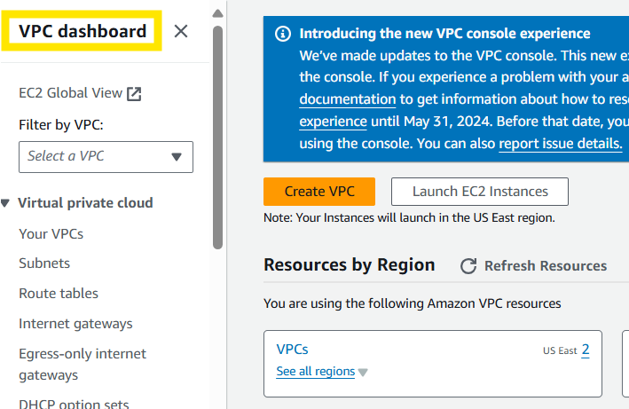
We will start at the VPC dashboard.

Slide 4
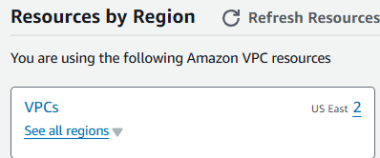
We will start at the VPC dashboard.
Go to VPCs.

Slide 5
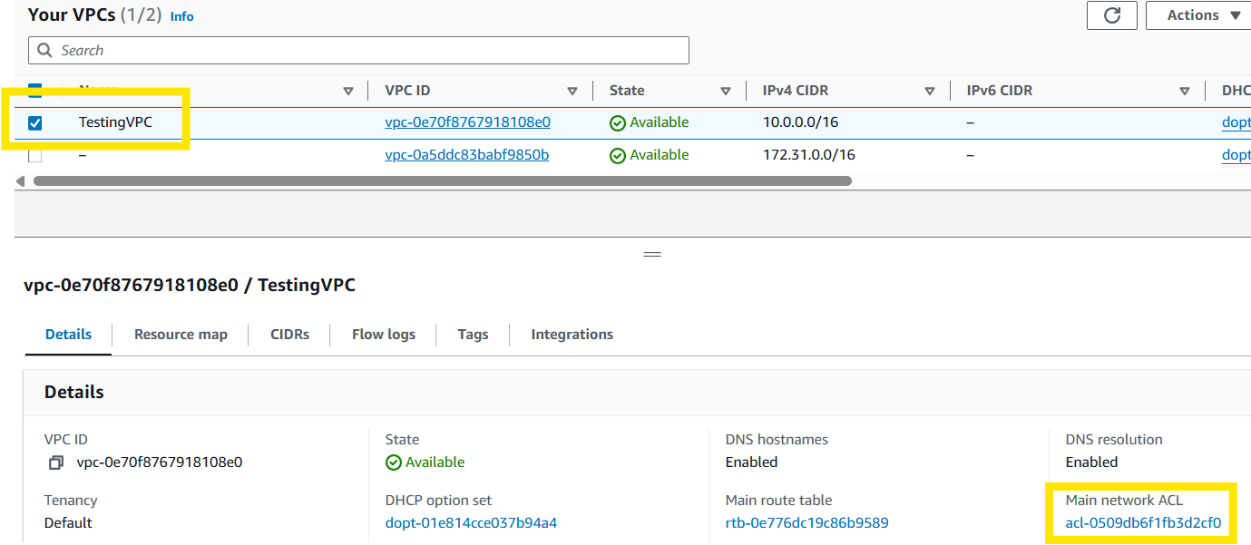
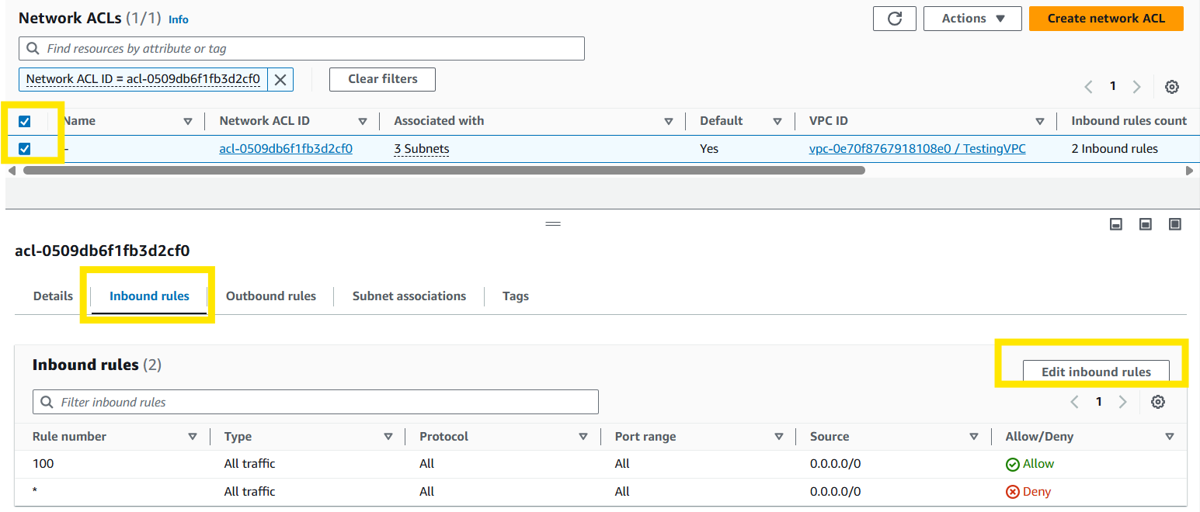
Choose your VPC, then select your network ACL.
Select your Network ACL, then select Inbound rules, the select edit inbound rules.

Slide 6
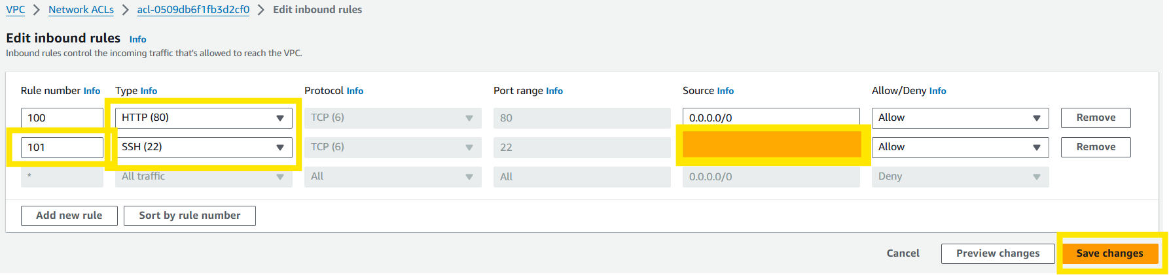
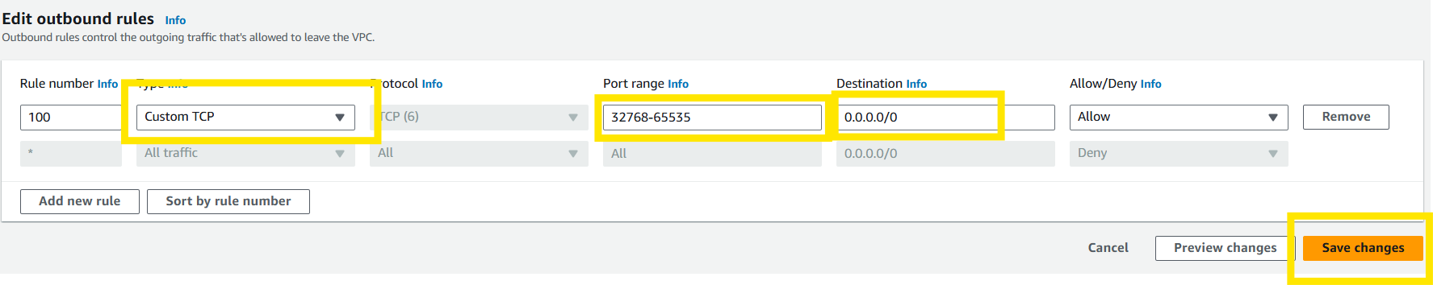
Add HTTP and SSH rules. Under SSH add your IP address to allow yourself access.
Now we go into the outbound rules and make a custom TCP with a smaller port range that can be accessed anywhere on the internet.

Slide 7
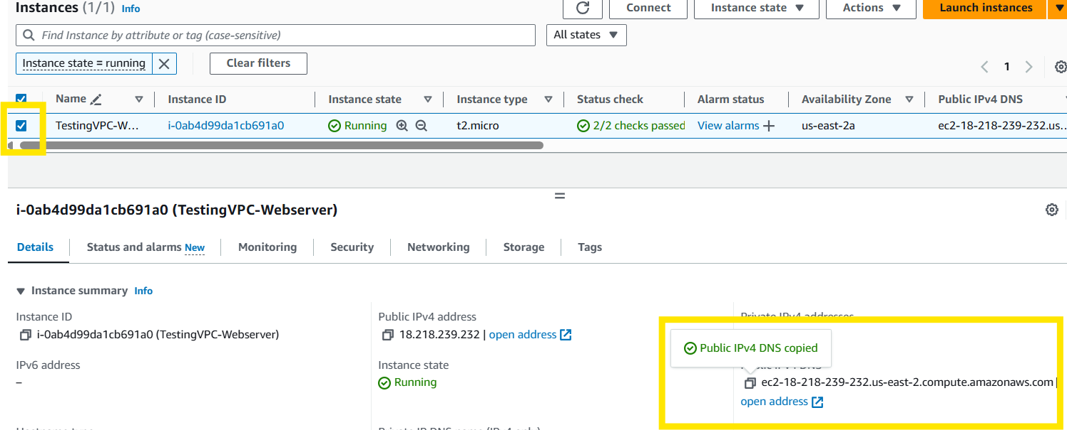
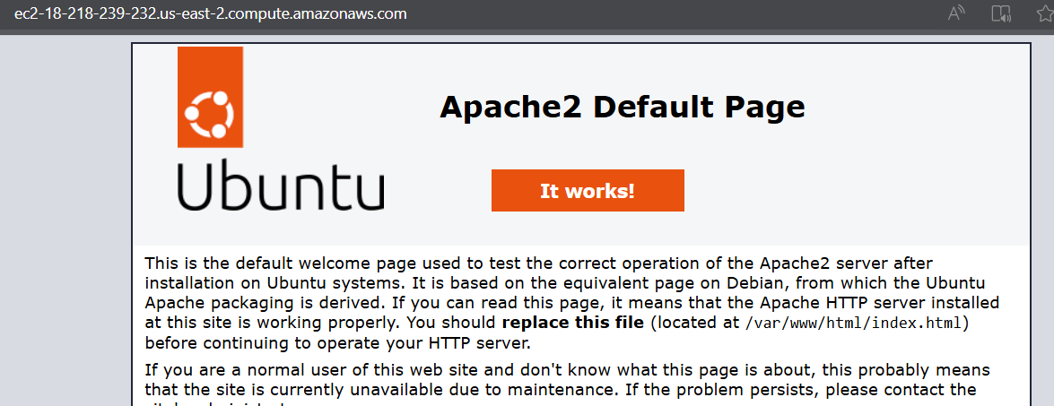
Go to your EC2 Instance and obtain the website address.
Paste the website address in the browser to verify that the changes you made work.

Slide 8
Go to your EC2 Instance and obtain the website address.
Paste the website address in the browser to verify that the changes you made work.

Slide 9
About – bastion hosts
Connects to servers on the Private subnet
Reminder
Is a secure way of connecting instances in the private subnet.
Is normally referred to as the jump server.
Apply OS hardening on the Bastion hosts.
Ensure right security groups are applied to the Bastion host.
Allow incoming traffic from select workstations to the bastion host.
For high availability deploy AWS bastion host in each availability zone within the region.

Slide 10
How to – bastion hosts
Create a new subnet for our private subnet.
Create a new route table to custom route our public subnets.
Ensure the private subnet does not have any routes that allow traffic onto the internet.
Launch an EC2 instance in the private and public subnets with the public subnet becoming our bastion host.
Connect to the Bastion Host.
Ensure Bastion Host security group only allows traffic from our workstation.
Connect Bastion Host to the private server via a secure method of using ssh-port forwarding.
*Note: You could copy the private key file to the Bastion Host and then connect to the private server, but it is not secure.
Download pageant tool (for Windows users), import the private key to pageant and use ssh-forwarding in the PuTTY tool.
Ensure inbound rules for the private server only allow SSH connections from the bastion security group.

Slide 11
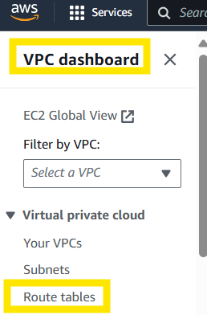
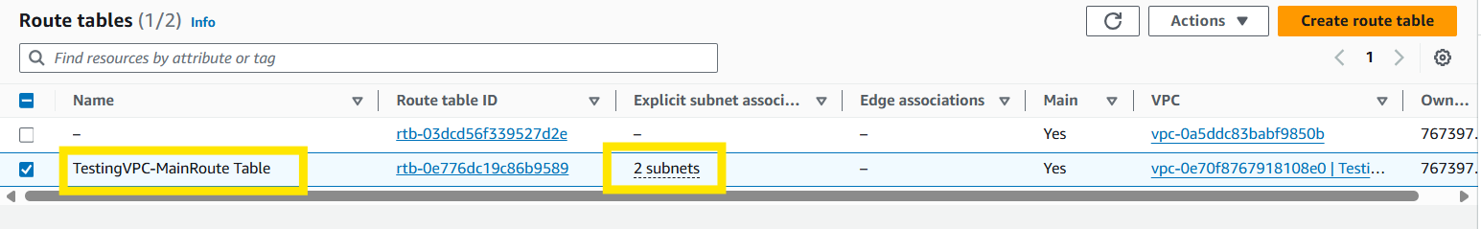
Go to your VPC dashboard and select Route tables.
Name your Route Table and verify it is connect to your two subnets. If not connect go to actions, edit subnet associations and add the two (2) subnets.

Slide 12
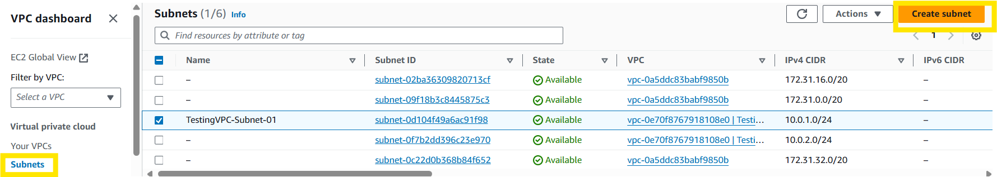
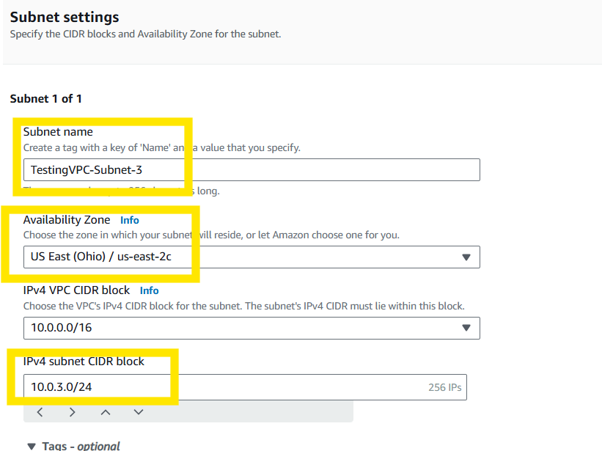
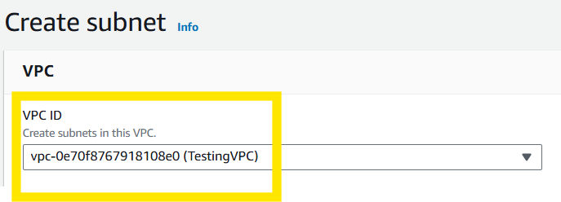
Go to your Subnets and select Create subnet.
Name your subnet, choose an availability zone outside the other two (2) subnets, put in your IPv4 subnet CIDR block, and select Create subnet.

Slide 13
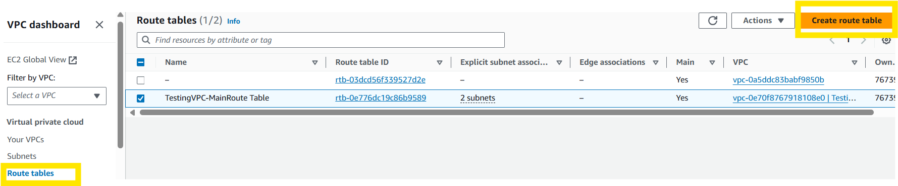
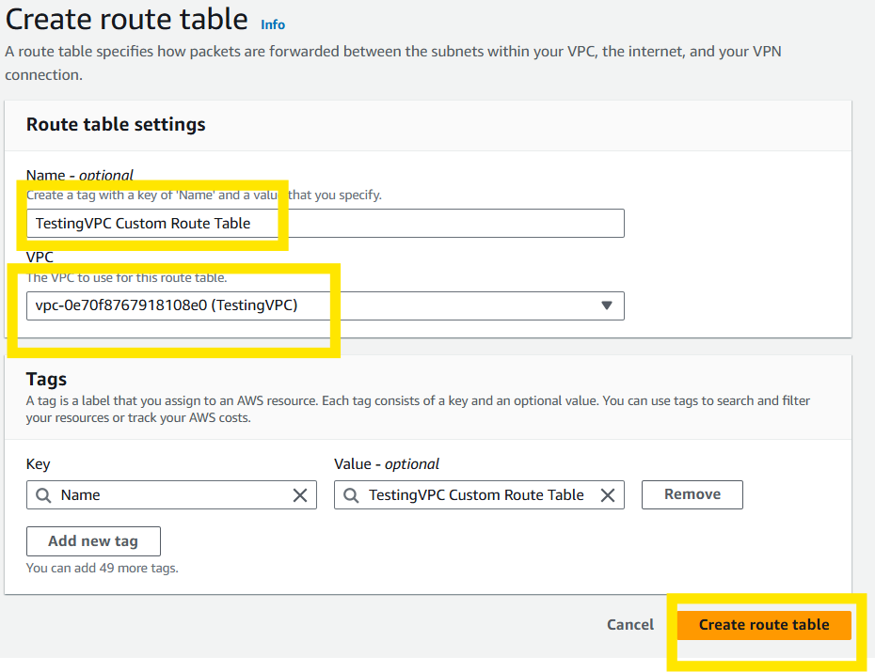
Select Route tables and Create route table.
Name the route table, choose your VPC, and select Create route table.

Slide 14
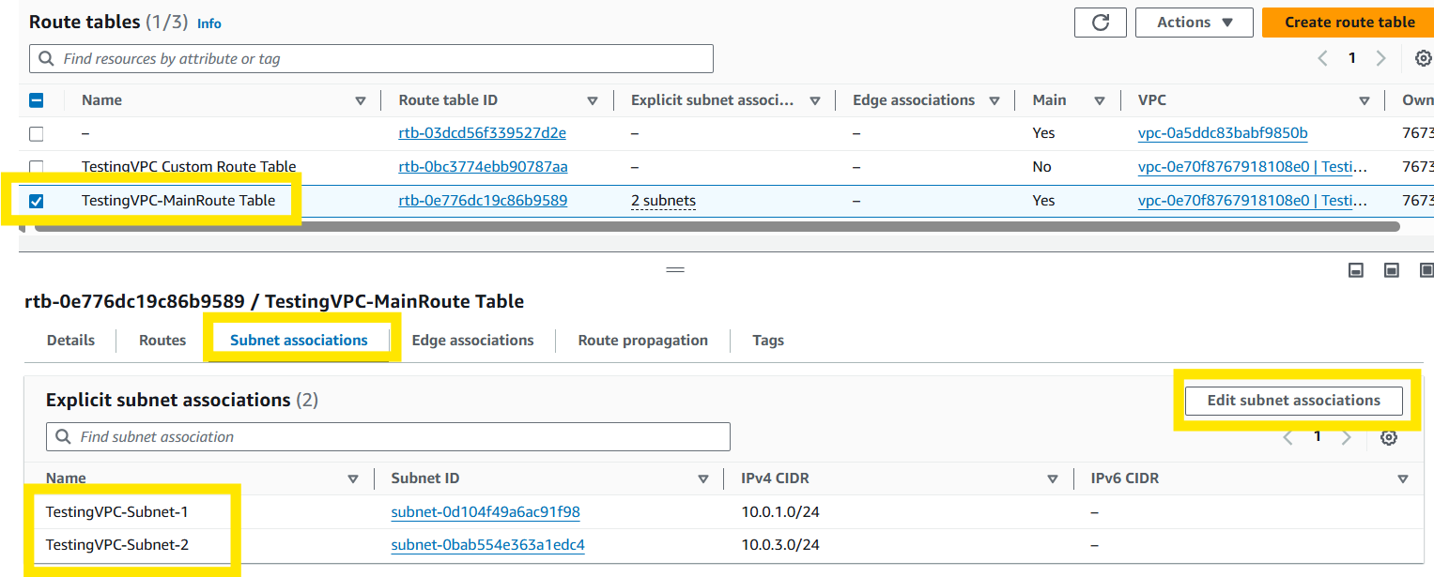
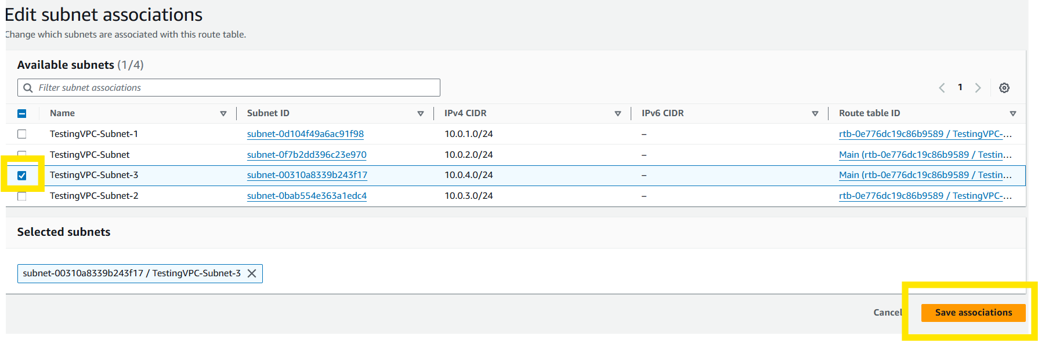
Go to your Route tables and delete subnets 1 &2 and add subnet 3.

Slide 15
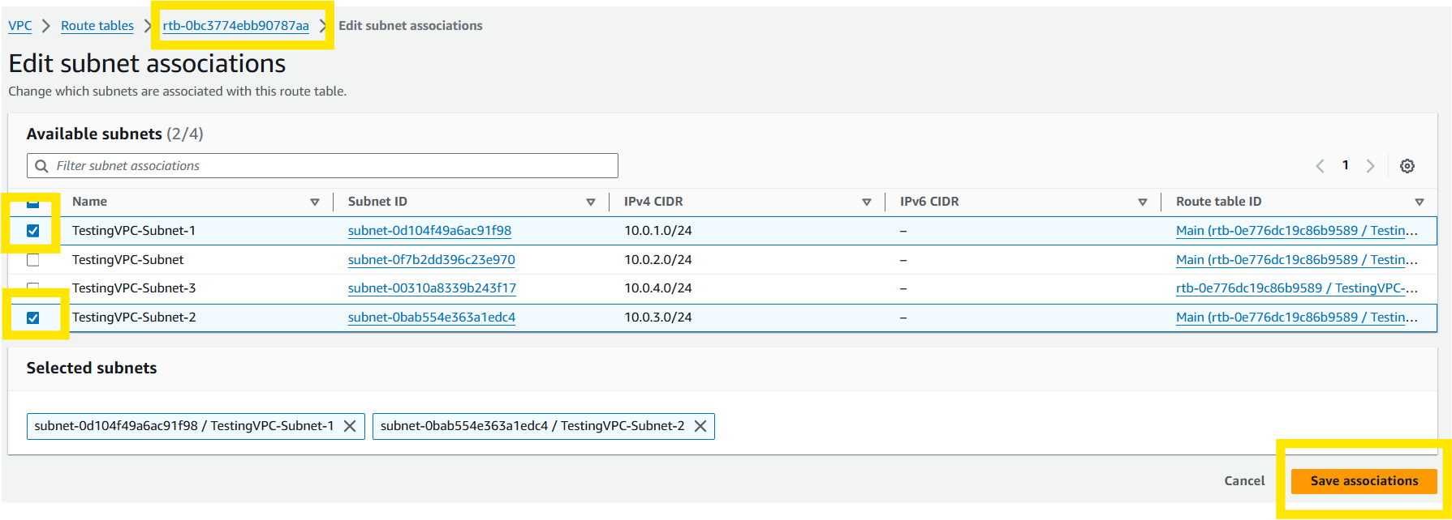
Go to your custom subnet and add subnets 1 and 2, and Save associations.

Slide 16
Go to your custom subnet and add subnets 1 and 2, and Save associations.

Slide 17
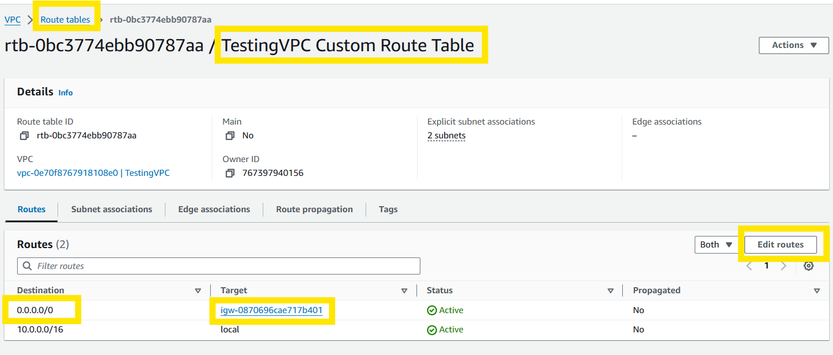
Go to the Route tables, select your Custom Route Table, Edit routes, choose and open destination IP address, set your target to your internet gateway, and click Save.

Slide 18
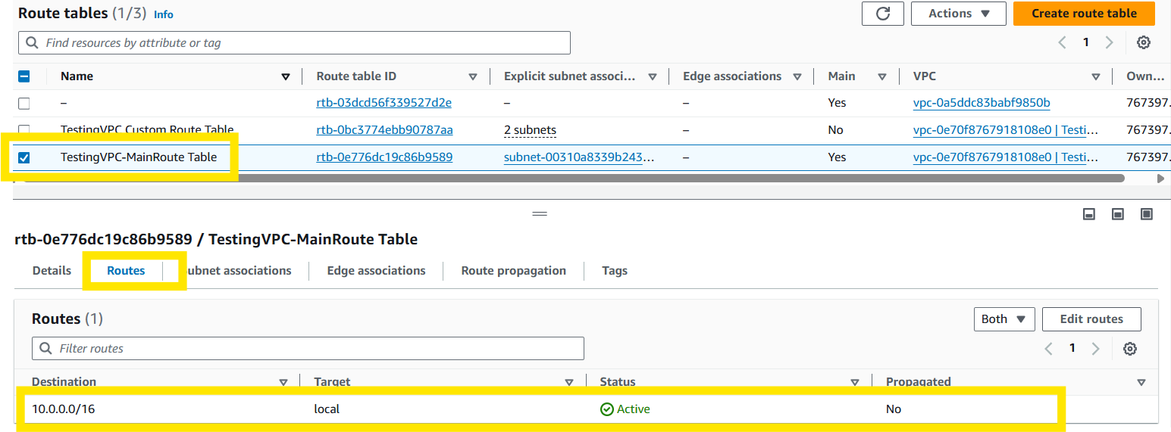
Go to the Route tables, select your Custom Route Table, Edit routes, choose and open destination IP address, set your target to your internet gateway, and click Save.
Next verify your main route table only has the local route table.

Slide 19
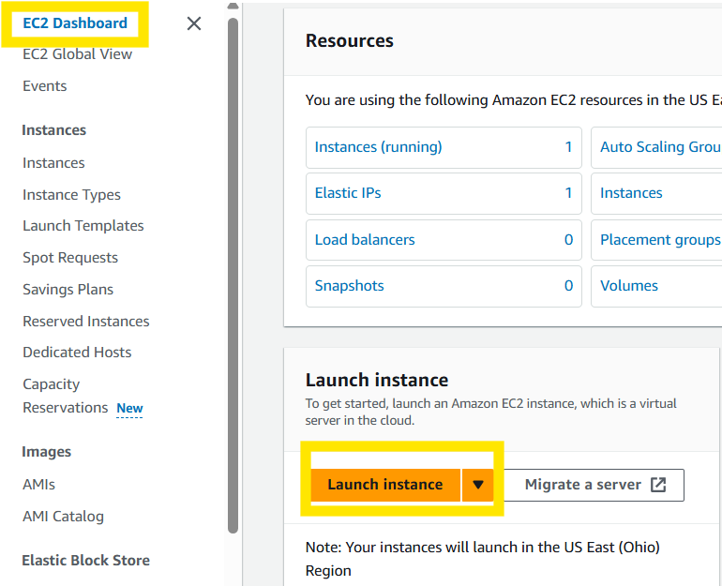
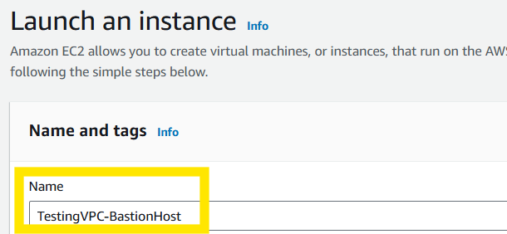
Go to the EC2 Dashboard and Launch a new instance.
Name your EC2 Instance

Slide 20
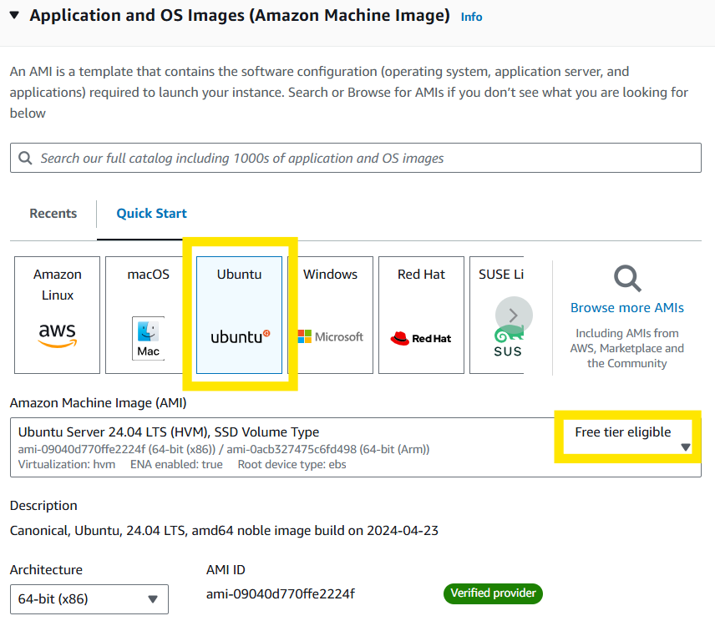
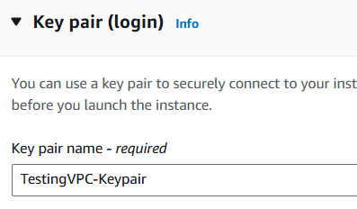
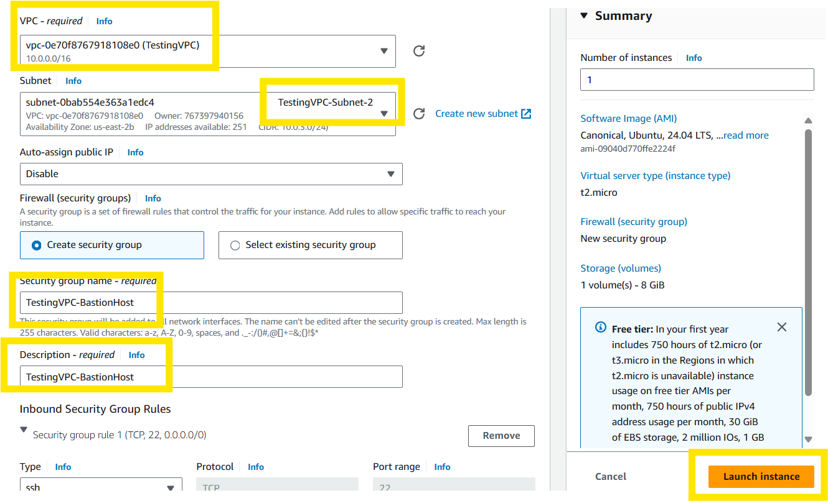
Select your OS image and assign your Key pair.
Update your VPC, update your subnet to #2, Update your security name and description, and Launch instance. When creating the BastionHost subnet select the auto-assign Public IP box.
* Do this step twice changing the subnet to #3 the second time and updating the name to Private Server.

Slide 21
Select your OS image and assign your Key pair.
Update your VPC, update your subnet to #2, Update your security name and description, and Launch instance.

Slide 22
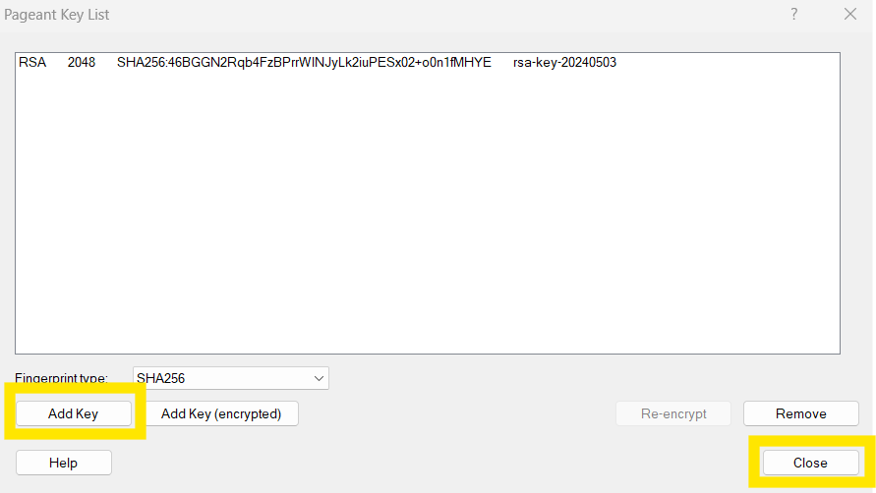
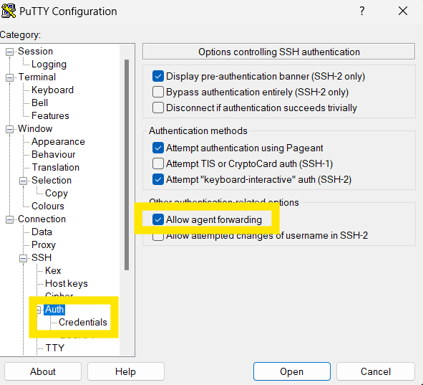
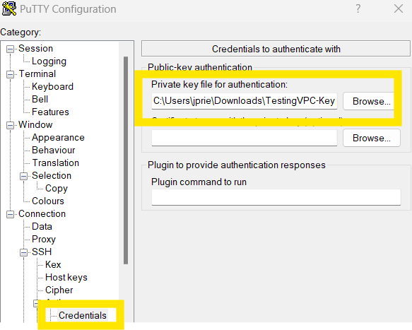
Use Pageant Key List to Add Key (Private Key from DL earlier) and then select close. Next open PuTTY and go down to Auth and select allow agent forwarding, then go to credentials and upload your private key file.

Slide 23
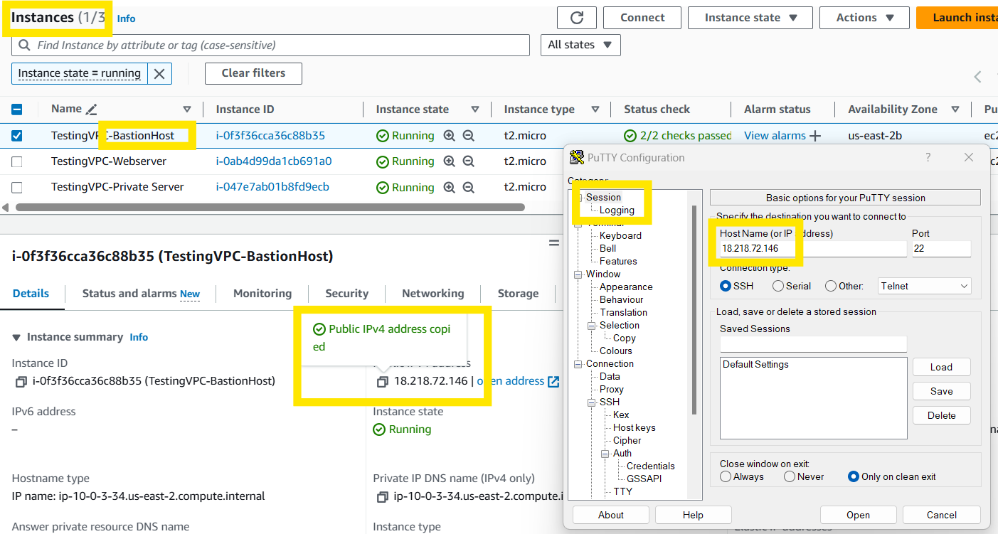
Go to your Instances, Bastion Host Instance, find the public IPv4 address and copy it. Then in PuTTY go to Session and insert the Bastion Host IP address into the Host Name field and select Open.

Slide 24

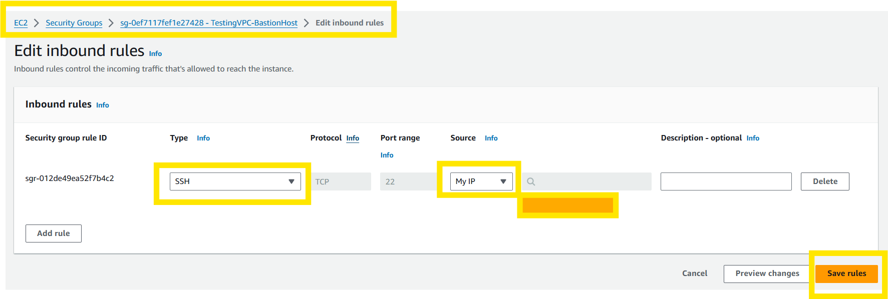
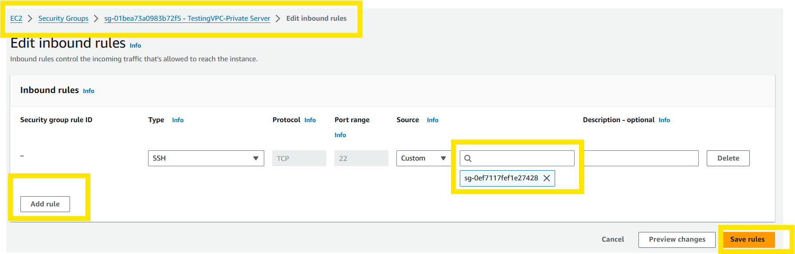
Next Login to your Bastion Host using your username from earlier.
Next, go into your Bastion Host Security Group and Edit Inbound rules to only allow your IP address or any IP address you want to access the site using Bastion.
Next, go into your private server security group and edit the inbound rules to only allow your Bastion server to have access to your private server.

Slide 25
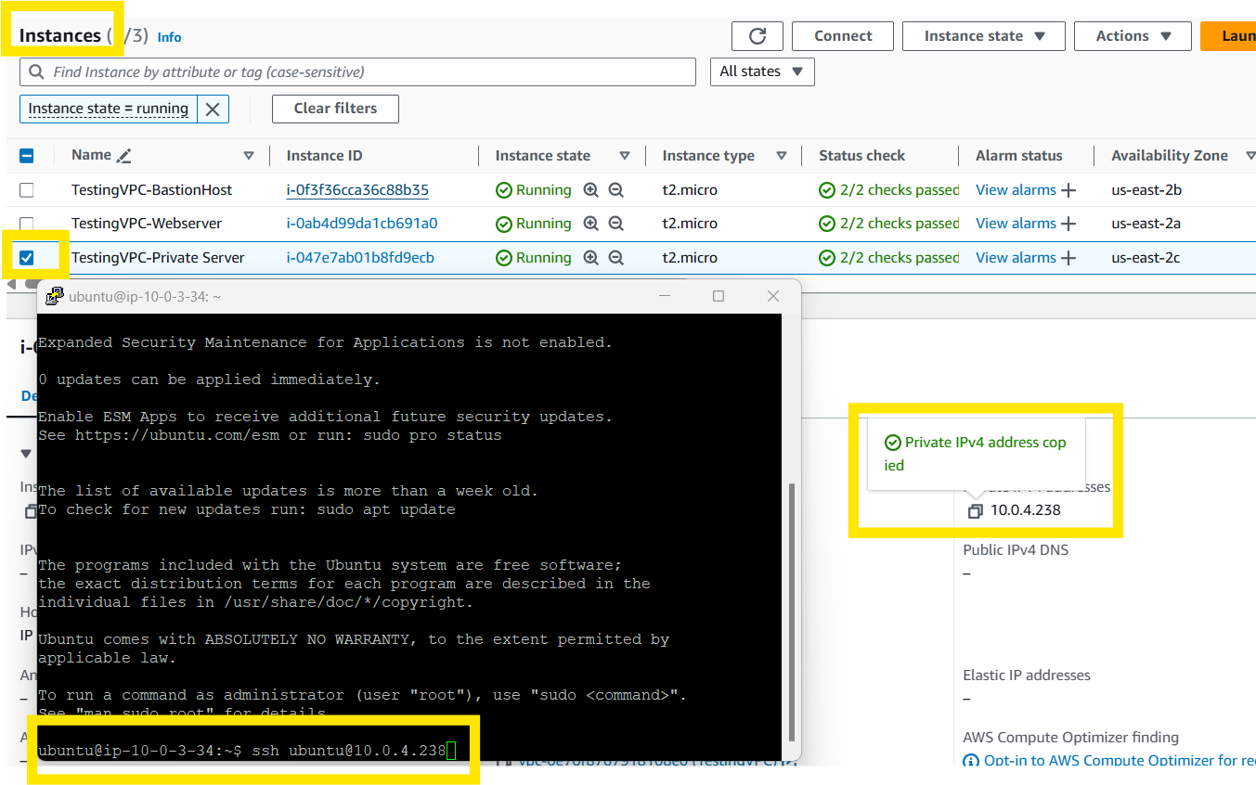
Next Login to your Bastion Host using your username from earlier.
This shows you that you can access your private server via Bastion Host as a jump server.

Slide 26


